Slide 1


Manuel E. Cano Nesbet
18-05-2025

Slide 2

Outline
Executive Summary
Introduction
Methodology
Results
Conclusion
Appendix

Slide 3
Executive Summary
Summary of Methodologies:
This project follows these steps:
Data Collection
Data Wrangling
Exploratory Data Analysis
Interactive Visual Analytics
Predictive Analysis (Classification)
Summary of Results:
This project produced the following outputs and visualizations:
Exploratory Data Analysis (EDA) results
Geospatial analytics
Interactive dashboard
Predictive analysis of classification models

Slide 4

Introduction
SpaceX's Falcon 9 rockets are launched at a significantly lower cost, around $62 million per flight, compared to the industry average of over $165 million.
A major reason for this cost advantage is the company's ability to recover and reuse the first stage of its rockets, reducing overall mission expenses.
Accurately predicting whether the first stage of the Falcon 9 will successfully land is critical for estimating the true cost of a launch.
This insight can help other companies decide whether to compete with SpaceX for contracts in the satellite launch market.
The goal of this project is to develop a model that can reliably forecast the likelihood of a successful landing for the Falcon 9 first stage.

Slide 5

Section 1

Slide 6
Methodology
Data Collection
Making GET requests to the SpaceX REST API
Web Scraping
Data Wrangling
Using the .fillna() method to remove NaN values
Using the .value_counts() method to determine the following:
Number of launches on each site
Number and occurrence of each orbit
Number and occurrence of mission outcome per orbit type
Creating a landing outcome label that shows the following:
0 when the booster did not land successfully
1 when the booster did land successfully
Exploratory Data Analysis
Using SQL queries to manipulate and evaluate the SpaceX dataset
Using Pandas and Matplotlib to visualize relationships between variables, and determine patterns
Interactive Visual Analytics
Geospatial analytics using Folium
Creating an interactive dashboard using Plotly Dash
Data Modelling and Evaluation
Using Scikit-Learn to:
Pre-process (standardize) the data
Split the data into training and testing data using train_test_split
Train different classification models
Find hyperparameters using GridSearchCV
Plotting confusion matrices for each classification model
Assessing the accuracy of each classification model

Slide 7

Data Collection
To gather comprehensive data for this analysis, a combination of API requests from the SpaceX REST API and web scraping from SpaceX's Wikipedia entry was employed. This approach was necessary to ensure complete and accurate data coverage for each launch.
Data Columns Collected via SpaceX REST API:
FlightNumber, Date, BoosterVersion, PayloadMass, Orbit, LaunchSite, Outcome, Flights, GridFins, Reused, Legs, LandingPad, Block, ReusedCount, Serial, Longitude, Latitude
Data Columns Collected via Wikipedia Web Scraping:
Flight No., Launch Site, Payload, Payload Mass, Orbit, Customer, Launch Outcome, Booster Version, Booster Landing, Date, Time

Slide 8
Data Collection – SpaceX API
Requesting
Requesting rocket launch data from SpaceX API
Decoding
Decoding the response content using .json() and turning it into a dataframe using .json_normalize()
Requesting
Requesting needed information about the launches from SpaceX API by applying custom functions
Constructing
Constructing data we have obtained into a dictionary
Creating
Creating a dataframe from the dictionary
Filtering
Filtering the dataframe to only include Falcon 9 launches
Replacing
Replacing missing values of Payload Mass column with calculated .mean() for this column
Exporting
Exporting the data to CSV
GitHub URL: Data Collection API

Slide 9
Data Collection - Scraping
Requesting
Requesting Falcon 9 launch data from Wikipedia
Creating
Creating a BeautifulSoup object from the HTML response
Extracting
Extracting all column names from the HTML table header
Collecting
Collecting the data by parsing HTML tables
Creating
Creating a dataframe from the dictionary
Constructing
Constructing data we have obtained into a dictionary
Exporting
Exporting the data to CSV
GitHub URL: Data Collection with web scraping

Slide 10
Data Wrangling
In this dataset, there are multiple possible outcomes for booster landings, not all of which are successful. For instance:
True Ocean: The booster successfully landed in a designated ocean region.
False Ocean: The booster attempted to land in the ocean but was unsuccessful.
True RTLS (Return to Launch Site): The booster successfully returned to a ground pad.
False RTLS: The booster attempted to return to a ground pad but failed.
True ASDS (Autonomous Spaceport Drone Ship): The booster successfully landed on a drone ship.
False ASDS: The booster attempted to land on a drone ship but was unsuccessful.
For training the machine learning model, these outcomes are simplified into binary labels:
1: Successful landing
0: Unsuccessful landing
Perform exploratory data analysis to identify key features and determine training labels
Calculate the number of launches from each site
Count the occurrences of each orbit type
Determine the number of successful and unsuccessful landings for each orbit type
Generate the final landing outcome labels based on the "Outcome" column
Export the cleaned and labeled data to a CSV file for further analysis
GitHub URL: Data Wrangling

Slide 11

EDA with Data Visualization
Exploratory Data Analysis (EDA) with Visualizations
Charts Created:
Flight Number vs. Payload Mass
Flight Number vs. Launch Site
Payload Mass vs. Launch Site
Orbit Type vs. Success Rate
Flight Number vs. Orbit Type
Payload Mass vs. Orbit Type
Yearly Trends in Success Rate
Chart Types and Their Purposes:
Scatter Plots: Used to identify potential relationships between pairs of numerical variables, helping to uncover patterns that could be valuable for training machine learning models.
Bar Charts: Effective for comparing discrete categories, illustrating the distribution and differences among key data points.
Line Charts: Ideal for tracking trends over time, capturing variations and changes in key metrics across different periods.
GitHub URL: EDA with Data Visualization

Slide 12
EDA with Data Visualization
Exploratory Data Analysis (EDA) with SQL
Performed SQL Queries:
Retrieve the unique launch site names used in space missions.
Select the first 5 launch site names that begin with the prefix "CCA".
Calculate the total payload mass for all boosters launched by NASA (CRS missions).
Determine the average payload mass for the booster version "F9 v1.1".
Find the date of the first successful ground pad landing.
List the boosters that successfully landed on a drone ship and carried payloads between 4000 and 6000 kg.
Count the total number of successful and unsuccessful mission outcomes.
Identify the booster versions that have carried the maximum payload mass.
List the failed drone ship landing outcomes, including booster versions and launch site names, for the months in 2015.
Rank the landing outcomes (e.g., "Failure" on a drone ship or "Success" on a ground pad) between June 4, 2010, and March 20, 2017, in descending order.
GitHub URL: EDA with SQL

Slide 13


Build an Interactive Map with Folium
Building an Interactive Map with Folium
Launch Site Markers:
Placed a circle marker for the NASA Johnson Space Center using its latitude and longitude coordinates as the initial focal point.
Added circle markers for all known launch sites, including popup labels and text annotations, to display their geographic positions and relative proximity to the equator and coastlines.
Color-Coded Markers for Launch Outcomes:
Incorporated color-coded markers to differentiate successful (green) and failed (red) launches using a marker clustering approach, making it easier to visualize the relative success rates at each launch site.
Measuring Distances to Nearby Features:
Added colored lines to indicate distances from the KSC LC-39A launch site (used as an example) to nearby infrastructure such as railways, highways, coastlines, and the closest city.
GitHub URL: Interactive Visual Analytics with Folium

Slide 14

Build a Dashboard with Plotly Dash
Building a Dashboard with Plotly Dash
Launch Site Dropdown Selector:
Implemented a dropdown menu to allow users to filter data by specific launch sites.
Pie Chart for Launch Success Rates (All Sites / Specific Site):
Added a pie chart to visualize the proportion of successful and failed launches, either for all sites collectively or for a selected launch site.
Payload Mass Range Slider:
Included a slider component to dynamically adjust the payload mass range, providing more control over data visualization.
Scatter Plot for Payload Mass vs. Success Rate:
Created a scatter plot to reveal the relationship between payload mass and launch success for different booster versions, highlighting potential performance trends.
GitHub URL: SpaceX Dash App

Slide 15

Predictive Analysis (Classification)
Preparing the Data:
Extract a NumPy array from the "Class" column to serve as the target variable
Data Standardization:
Standardize the feature data using StandardScaler, fitting and transforming it for improved model performance
Data Splitting:
Divide the dataset into training and testing subsets using the train_test_split function to evaluate model accuracy.
Hyperparameter Tuning:
Create a GridSearchCV object with 10-fold cross-validation (cv=10) to identify the best model parameters.
Model Training and Evaluation:
Apply GridSearchCV to various models, including Logistic Regression, SVM, Decision Trees, and KNN.
Model Accuracy Assessment:
Calculate the accuracy of each model on the test data using the .score() method.
Confusion Matrix Analysis:
Generate confusion matrices to assess model performance across different classes.
Selecting the Best Model:
Use the Jaccard score and F1 score metrics to determine which model performs the best.
GitHub URL: Machine Learning prediction

Slide 16
Results
Exploratory Data Analysis Results
Interactive Analytics demo in screenshots
Predictive Analysis Results

Slide 17

Section 2

Slide 18
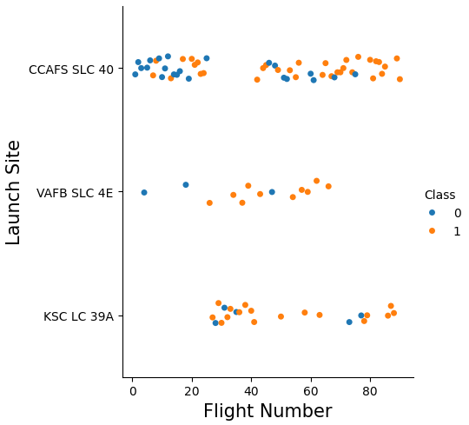
Flight Number vs. Launch Site
Insights from the Scatter Plot: Launch Site vs. Flight Number
Increasing Success with More Flights:
The overall success rate at each launch site tends to improve as the number of flights increases.
Early Launch Challenges at CCAFS SLC 40:
Most early flights (with flight numbers below 30) were conducted from CCAFS SLC 40, and these missions had a relatively low success rate.
Similar Trends at VAFB SLC 4E:
Early launches from VAFB SLC 4E also showed lower success rates, reinforcing the trend that early missions often faced more challenges.
High Success Rates at KSC LC 39A:
KSC LC 39A, which did not host any early flights, has a notably higher success rate, suggesting that it benefited from more mature technology and operational experience.
Significant Improvement After 30 Flights:
Once flight numbers surpass 30, the success rate increases significantly, indicating a learning curve effect as SpaceX refined its technology and operations.

Slide 19
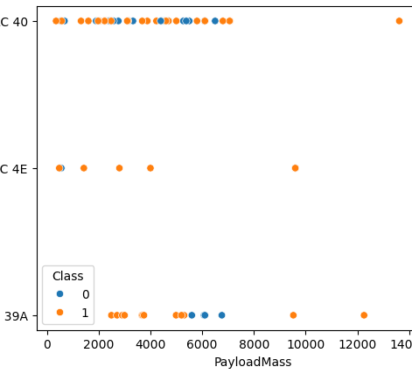
Payload vs. Launch Site
Insights from the Scatter Plot: Launch Site vs. Payload Mass
Heavier Payloads Show Higher Success:
For payloads above approximately 7000 kg, unsuccessful landings are rare, though this may be partly due to the limited number of heavier launches in the dataset.
Weak Correlation Between Mass and Success:
There is no strong or consistent relationship between payload mass and success rate at individual launch sites.
Wide Range of Payloads Across Sites:
All launch sites have handled a broad range of payload masses, though CCAFS SLC 40 has a higher concentration of lighter payloads, with a few notable outliers.

Slide 20
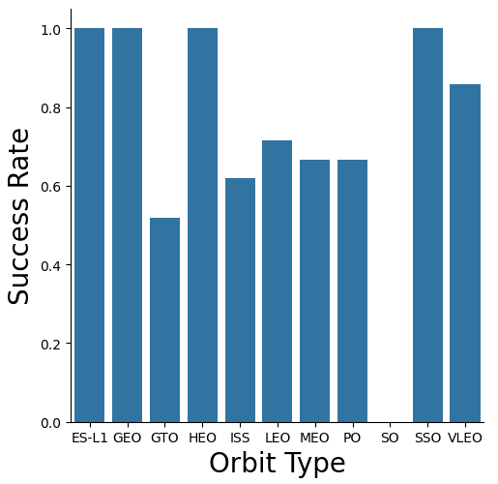
Success rate vs. Orbit Type
Insights from the Bar Chart: Success Rate vs. Orbit Type
Orbits with a 100% Success Rate:
ES-L1 (Earth-Sun First Lagrangian Point)
GEO (Geostationary Orbit)
HEO (High Earth Orbit)
SSO (Sun-synchronous Orbit)
Orbit with a 0% Success Rate:
SO (Heliocentric Orbit)

Slide 21
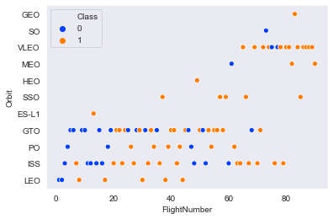
Flight Number vs. Orbit Type
Insights from the Scatter Plot: Orbit Type vs. Flight Number
High Success Rates with Limited Flights:
The 100% success rates for GEO (Geostationary Orbit), HEO (High Earth Orbit), and ES-L1 (Earth-Sun First Lagrangian Point) are largely due to each having only a single recorded flight.
Consistent Success for SSO:
The SSO (Sun-synchronous Orbit) stands out with a more meaningful 100% success rate, achieved across 5 successful flights.
Weak Correlation for GTO:
There appears to be little or no clear relationship between flight number and success rate for GTO (Geostationary Transfer Orbit).
Improving Success with Experience:
In general, success rates tend to improve as flight numbers increase, especially for LEO (Low Earth Orbit), where most unsuccessful landings occurred during early launches.

Slide 22
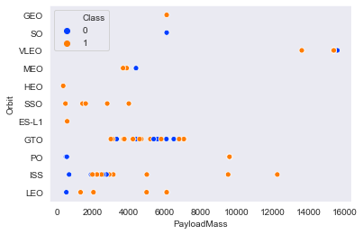
Payload vs. Orbit Type
Insights from the Scatter Plot: Orbit Type vs. Payload Mass
Orbits with Higher Success for Heavier Payloads:
PO (Polar Orbit) – Despite having a limited number of data points, this orbit shows a trend of successful heavy payload launches.
ISS (International Space Station) – Consistently supports heavier payloads with high success rates.
LEO (Low Earth Orbit) – Also shows a positive relationship between heavier payloads and successful missions.
Unclear Trends for GTO:
For GTO (Geostationary Transfer Orbit), the relationship between payload mass and success rate remains ambiguous.
VLEO Association with Heavy Payloads:
VLEO (Very Low Earth Orbit) launches are typically associated with heavier payloads, which aligns with expectations given the nature of this orbit.

Slide 23
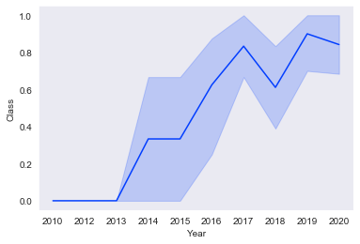
Launch Success Yearly Trend
Insights from the Line Chart: Yearly Average Success Rate
Early Challenges (2010-2013):
From 2010 to 2013, all landings were unsuccessful, resulting in a 0% success rate during this period.
Steady Improvement After 2013:
Success rates generally improved after 2013, although there were minor setbacks in 2018 and 2020.
Consistent High Performance After 2016:
Since 2016, the success rate has consistently remained above 50%, indicating a significant increase in overall reliability.

Slide 24
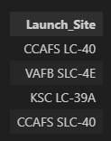
All Launch Site Names
Displaying 5 records where launch sites begin with the string 'CCA'.
The word distinct returns only unique values from the LAUNCH_SITE column of the SPACEXTBL table.

Slide 25
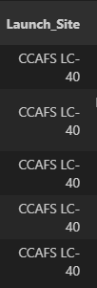
Launch Site Names Begin with 'CCA'
limit 5 fetches only 5 records, and the like keyword is used with the wild card ‘CCA%’ to retrieve string values beginning with ‘CCA’.

Slide 26

Total Payload Mass
Displaying the total payload mass carried by boosters launched by NASA (CRS)

Slide 27
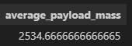
Average Payload Mass by F9 v1.1
Displaying average payload mass carried by booster version F9 v1.1

Slide 28

First Successful Ground Landing Date
Listing the date when the first successful landing outcome in ground pad was achieved

Slide 29
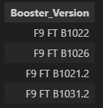
Successful Drone Ship Landing with Payload between 4000 and 6000
Listing the names of the boosters which have success in drone ship and have payload mass greater than 4000 but less than 6000

Slide 30
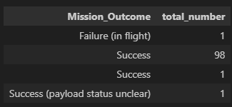
Total Number of Successful and Failure Mission Outcomes
Listing the total number of successful and failure mission outcomes

Slide 31
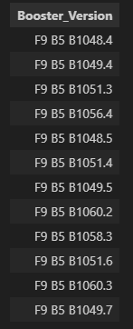
Boosters Carried Maximum Payload
Listing the names of the booster versions which have carried the maximum payload mass

Slide 32
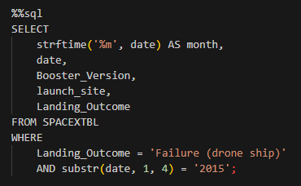
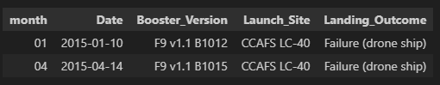
2015 Launch Records
Listing the failed landing outcomes in drone ship, their booster versions and launch site names for the months in year 2015

Slide 33
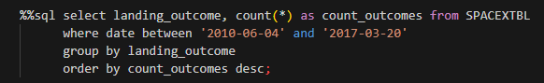
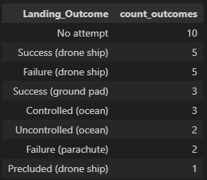
Rank Landing Outcomes Between 2010-06-04 and 2017-03-20
Ranking the count of landing outcomes (such as Failure (drone ship) or Success (ground pad)) between the date 2010-06-04 and 2017-03-20 in descending order

Slide 34

Section 3

Slide 35
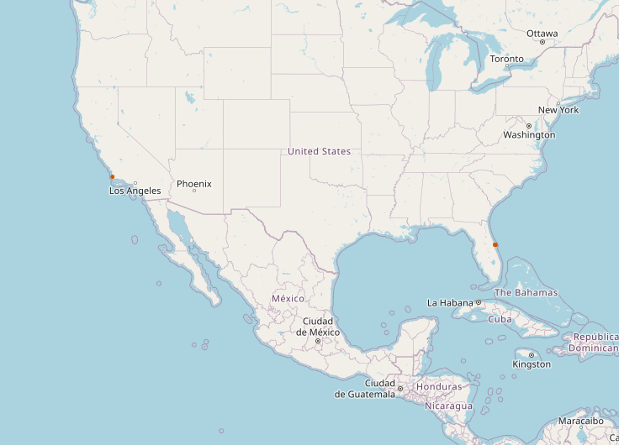
All launch sites’ location markers on a global map
Proximity to the Equator:
Most launch sites are located close to the equator. This is advantageous because the rotational speed of the Earth is greatest at the equator, approximately 1670 km/hour.
Launching from this region provides a "speed boost" due to inertia, as the spacecraft already has this eastward velocity when it leaves the ground, reducing the amount of fuel needed to reach orbital speed.
Coastal Locations for Safety:
Launch sites are typically near coastlines to ensure that rockets launch over open water. This minimizes the risk to populated areas from potential debris, launch failures, or explosions, making the process significantly safer.

Slide 36
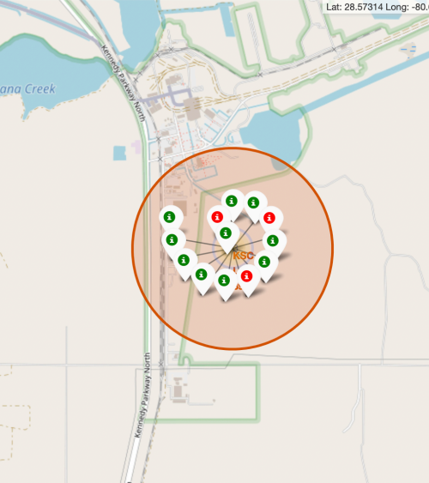
Colour labeled launch records on the map
Color-Coded Success Indicators:
The use of color-labeled markers makes it straightforward to identify which launch sites have relatively high success rates.
Green Marker = Successful Launch
Red Marker = Failed Launch
High Success at KSC LC-39A:
The KSC LC-39A launch site stands out for its notably high success rate, indicating reliable performance over multiple missions

Slide 37
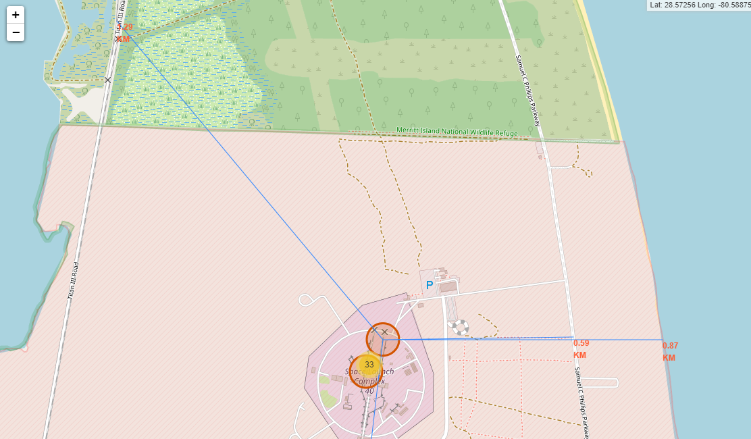
Distance from the launch site
KSC LC-39A to its proximities
Close to Highways
Close to coastline (870 m.)

Slide 38

Section 4

Slide 39
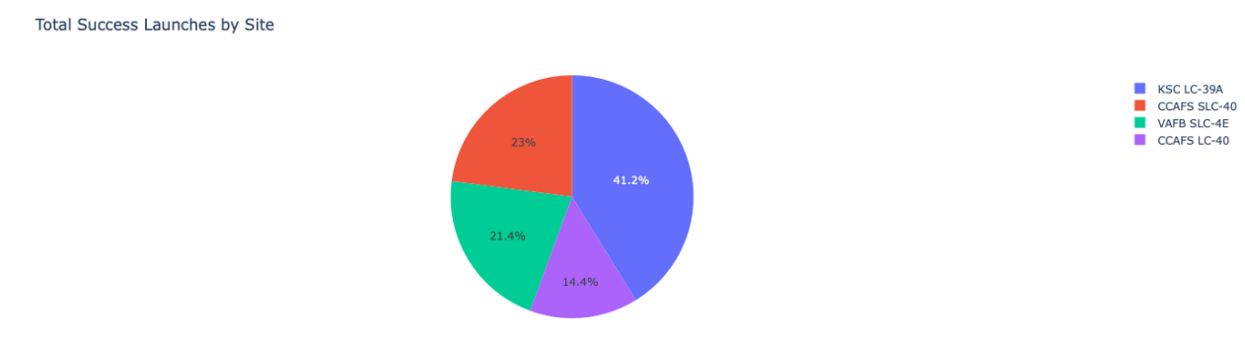
Launch success count for all sites
The chart clearly shows that from all the sites, KSC LC-39A has the most successful launches

Slide 40
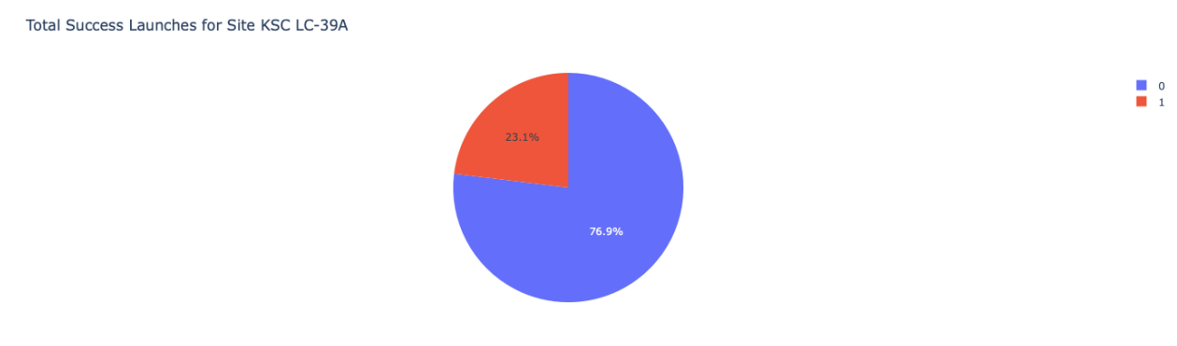
Launch site with highest launch success ratio
• KSC LC-39A has the highest launch success rate (76.9%) with 10 successful and only 3 failed landings.

Slide 41
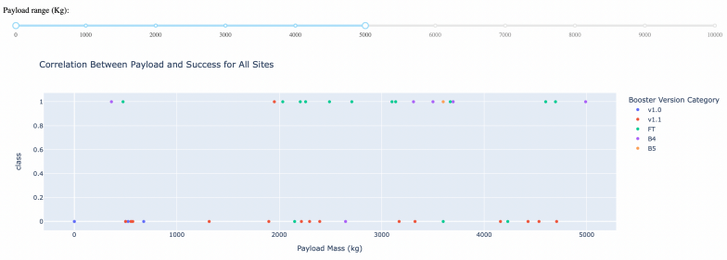
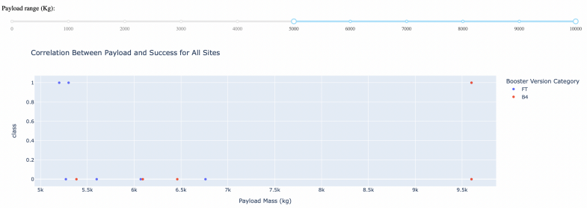
Payload Mass vs. Launch Outcome for all sites
The charts show that payloads between 2000 and 5500 kg have the highest success rate

Slide 42

Section 5

Slide 43
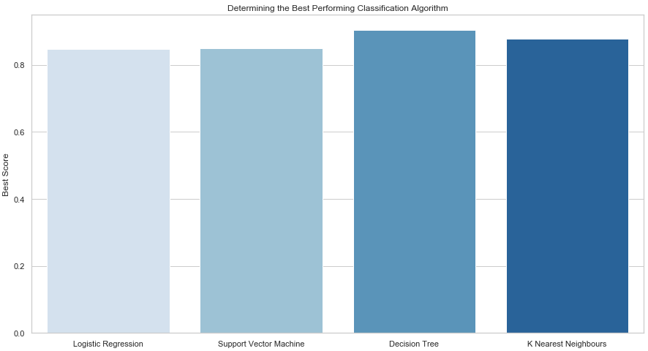
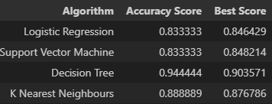
Classification Accuracy
Plotting the Accuracy Score and Best Score for each classification algorithm produces the following result:
The Decision Tree model has the highest classification accuracy
The Accuracy Score is 94.44%
The Best Score is 90.36%

Slide 44
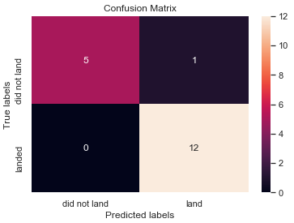
Confusion Matrix
As shown previously, best performing classification model is the Decision Tree model, with an accuracy of 94.44%.
This is explained by the confusion matrix, which shows only 1 out of 18 total results classified incorrectly (a false positive, shown in the top-right corner).
The other 17 results are correctly classified (5 did not land, 12 did land).

Slide 45

Conclusions
Key Findings:
Impact of Flight Experience on Success Rates:
As the number of flights increases, the success rate at each launch site generally improves.
Early Challenges: From 2010 to 2013, all landings were unsuccessful (0% success rate).
Consistent Improvement: After 2013, success rates steadily improved, despite minor setbacks in 2018 and 2020.
High Reliability: Since 2016, the success rate has consistently remained above 50%.
High Success Orbit Types:
100% Success Orbits:
ES-L1 (Earth-Sun First Lagrangian Point)
GEO (Geostationary Orbit)
HEO (High Earth Orbit)
SSO (Sun-synchronous Orbit) - more impressive with 5 successful flights.
Heavy Payload Success:
PO (Polar Orbit), ISS (International Space Station), and LEO (Low Earth Orbit) orbits tend to support heavier payloads with higher success rates.
VLEO (Very Low Earth Orbit) is also associated with heavier payloads, aligning with its design purpose.
Top-Performing Launch Site:
KSC LC-39A had the most successful launches, accounting for 41.7% of total successful launches, and the highest individual site success rate at 76.9%.
Payload Size and Success Rates:
The success rate for massive payloads (over 4000 kg) is generally lower than that for lighter payloads.
Best Classification Model:
The Decision Tree Model emerged as the best-performing classification model, achieving an accuracy of 94.44%.

Slide 46
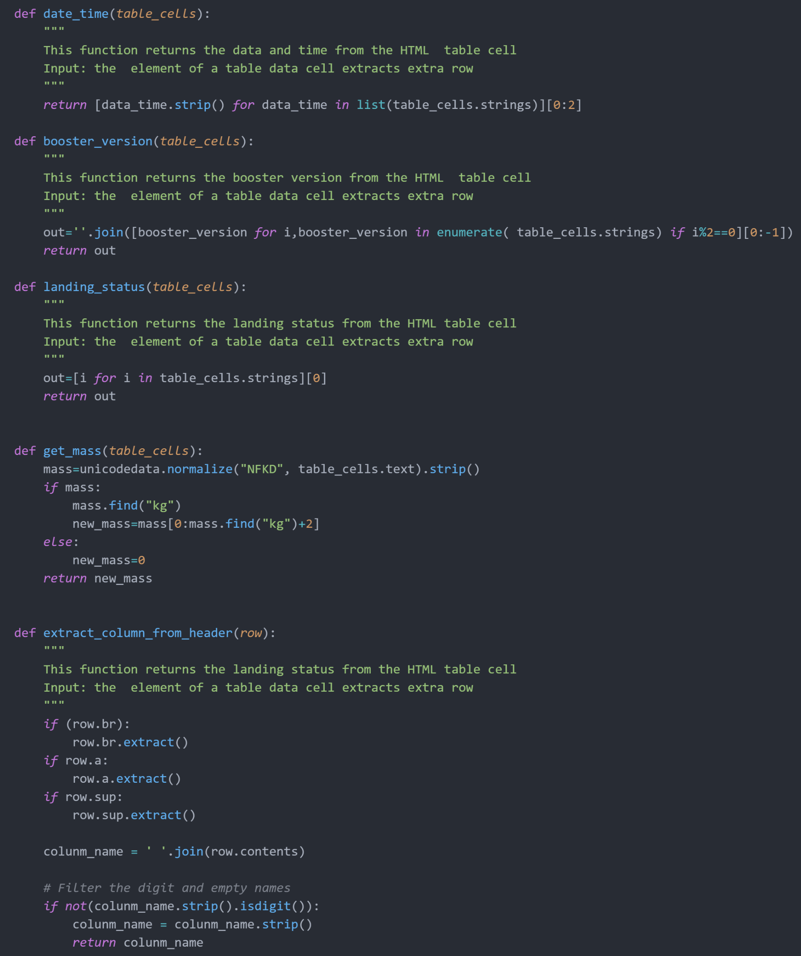
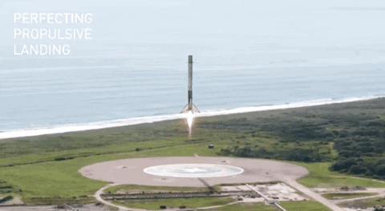
Appendix
Auxiliary Functions for Data Collection – Web Scraping

Slide 47


